Slide 1

Data Acquisition
Get started with a workflow, read data from various sources
Yordan Darakchiev
Technical Trainer
iordan93@gmail.com

Slide 2
sli.do #Data-Science

Slide 3
Table of Contents
The scientific method
Setting up the environment
Reading data from different sources
Text files
Excel
Web services
SQL databases
Data consolidation principles

Slide 4
The Scientific Method
How not to get lost: a quick reminder

Slide 5
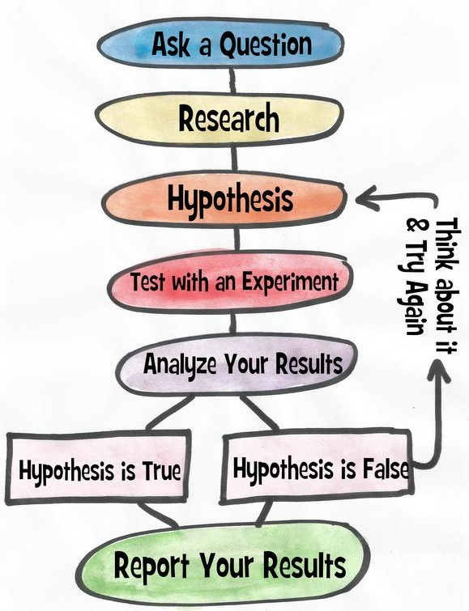

The Scientific Method Steps
Ask a question
Do some research
Form a hypothesis
Test the hypothesis with an experiment
Experiment works $⇒$ Analyze the data
Experiment doesn't work $⇒$ Fix experiment
Results align with hypothesis $⇒$ OK
Results don't align with hypothesis $⇒$ new question, new hypothesis
Communicate the results

Slide 6
Getting Data
Reading data from various sources

Slide 7
The pandas Library
Provides a way to read and work with data
Table (DataFrame)
May have many dimensions
We usually call this a "dataset"
List (Series)
One-dimensional
Usually represents a column of a table
Usage
General requirements
Rows and columns are indexed, columns may have names
Each column has a fixed data type
Python will try to infer the best type according to the data
import pandas as pd

Slide 8
Data Sources
In order to work with the data, we need to represent it in tabular form
Sometimes our data is tabular – we just need to read it
In other cases, we need to create our tables
Unstructured data: data that doesn't have a model
There is some structure, it’s just not very clear
Examples: Images, plain text, audio, web pages
Most common sources
Tables in a text format such as .csv
Spreadsheets (such as Excel or Google Sheets)
Web services
Databases

Slide 9
Reading a Local File
Let's read the file accidents.csv
Copy the file to a data folder
Not required, just makes working with many data files easier
Inspect the file (use a text editor or Excel) just to see what it contains
read_csv() docs
You'll see that all read_*() functions have a lot of optional arguments
They make working with different formats easy, e.g.
Instead of True and False, the table contains "Yes" and "No"
The actual table starts at line 30 of the file
There are blank / comment lines which should be skipped
There are no column names in the file
accidents_data = pd.read_csv("data/accidents.csv")

Slide 10
Exploring the Dataset
In Python, we can print the variable
Even better, in Jupyter, a cell outputs its last returned value
This will create a nicer output
We can see that
Rows have numerical indices starting at 0 by default
Columns have names taken from the first line in the .csv file
Column names:
Index values:
Dimensions:
Format: (rows, columns)
print(accidents_data)
accidents_data
accidents_data.columns
accidents_data.index
accidents_data.shape

Slide 11
Reading Data from Other Files
The process is very similar
Other text-based formats
pd.read_table() is the most general function
All others (read_csv(), read_fwf(), etc.) just apply some settings
If we come across a file, we can apply our own settings
The point is to match the format in the best possible way
Example: AutoMPG dataset
Excel
Read the green_tripdata_2015-09.xls file using pd.read_excel()
Explore the file dimensions

Slide 12
Reading Data from Web Services
Web services work over the HTTP protocol and provide data in several formats
Most commonly used: JSON and XML
Some APIs to try
Example: OpenLibrary API
We want information about books with ISBNs
Example: these 4 books
We can put the URL directly, pandas will perform a GET request
Function: pd.read_json()
We can provide the parameter orient = "index" to arrange the dataset better
Books should be placed by rows, their properties – by columns
More details on this – next time
More complex queries require more pre-processing

Slide 13
Reading Data from SQL
Relational databases store data in tables
Very similar to the datasets we use
First, install a library to connect to databases
From the command line:
Then, import the library and connect to the database
Note: This is going to vary depending on your server settings
Perform a query
conda install pyodbc
import pyodbc
conn = pyodbc.connect("DRIVER={SQL Server};...")
customer_info = pd.read_sql(
"select * from Sales.Customer",
conn)

Slide 14
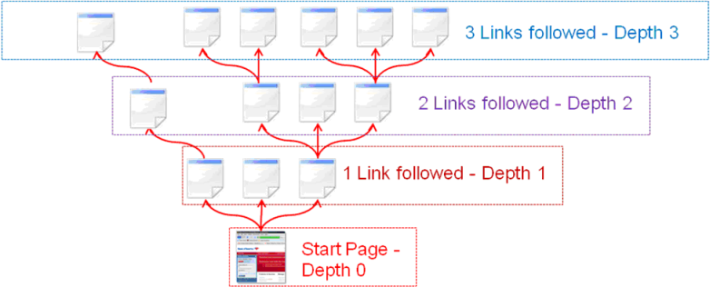
Web Scraping
Another method for getting data
Sometimes combined with crawling
Traversing a Web page structure recursively
Basic procedure
Read a Web page as HTML
Use the HTML to obtain the data
A webpage is unstructured
We need to create and maintain the structure
We usually need more libraries to do that
Examples
Get all job listings from a website
Get user contact details from a Web page

Slide 15
Using Multiple Sources
Constraints and Validity

Slide 16
Data Guidelines
Some queries will not be simple
E.g. scraping, dealing with "freeform" text, audio data, networks
We need to create a tabular structure from the raw data
How? We’ll discuss this later in the course
After we read the data, we have to ensure it's been read without errors
A very simple first check: check the dimensions (dataframe.shape) and show the first few rows (dataframe.head())
We may need to rename columns
We may need to perform different manipulations to ensure the data is in a proper state
We'll do this in the next lectures

Slide 17
Merging Many Data Sources
Automate the process as much as possible
From reading the raw data to getting the processed dataset
If the dataset changes or updates, you’ll just re-run your code
Document the process
Create as few datasets as possible
I.e. merge many sources into one table if you can
We’ll talk more about combining relations next time
Ensure the different sources are compatible and consistent
If they aren’t, process the raw data
Most common example: Mismatched IDs
Make sure all column types are correct
Check: dataframe.dtypes
Example: str type for a numeric column

Slide 18
Summary
Methods
Divide and conquer
Scientific method
Setting up the environment
Reading data from different sources
Text files
Excel
Web services
SQL databases
Data consolidation principles

